Slide 1
DengAI : Predicting Disease Spread
140441N - N. C. N. C. Pathirana
140552F - R. S. Samarawickrama
140575D - I. S. Seneviratne
140701M - S. L. S. Wolff

Slide 2
Introduction
Dengue is a mosquito borne disease caused by dengue viruses.
Over the years it has spread rapidly causing deaths due to different factors that are congenial for it.
Temperature
Climate changes
Uncontrolled urbanization
Poor infrastructure

Slide 3
Introduction ctd.
Data set for the prediction was based on two cities; San Juan and Iquitos .
Data set included the following features.
City and Data Indicators
City - sj for San Juan and iq Iquitos
Week_start_date - Date given in yyyy-mm-dd format
NOAA’s GHCN Daily Climate Data weather station measurement
station_max_temp_c - maximum temperature
station_min_temp_c - minimum temperature
station_avg_temp_c - average temperature
station_percip_mm - total precipitation
station_diur_temp_rng_c - Diurnal temperature range

Slide 4
Introduction ctd.
NOAA's NCEP Climate Forecast System Reanalysis measurements (0.5x0.5 degree scale)
reanalysis_sat_precip_amt_mm– Total precipitation
reanalysis_dew_point_temp_k– Mean dew point temperature
reanalysis_air_temp_k– Mean air temperature
reanalysis_relative_humidity_percent– Mean relative humidity
reanalysis_specific_humidity_g_per_kg– Mean specific humidity
reanalysis_precip_amt_kg_per_m2– Total precipitation
reanalysis_max_air_temp_k– Maximum air temperature
reanalysis_min_temp_air_k– Minimum air temperature
reanalysis_avg_temp_k– Average air temperature
reanalysis_tdtr_k– Diurnal temperature range

Slide 5
Introduction ctd.
PERSIANN satellite precipitation measurements (0.25x0.25 degree scale)
precipitation_amt_mm – Total precipitation
Satellite vegetation - Normalized difference vegetation index (NDVI) - NOAA's CDR Normalized Difference Vegetation Index(0.5x0.5 degree scale) measurements
ndvi_se– Pixel southeast of city centroid
ndvi_sw– Pixel southwest of city centroid
ndvi_ne– Pixel northeast of city centroid
ndvi_nw– Pixel northwest of city centroid

Slide 6
Problem
Given the above datasets along with the number of reported dengue cases, the problem can be identified as to predict the number of future dengue cases that may be reported if other features are known.
The problem belongs to supervised learning category and it is a regression problem.

Slide 7
Motivation
Identify and prevent fatal diseases like Dengue before they spread and cause more harm to human lives.
Early prediction of dengue cases helps health care providers to draw conclusions about future disease spread patterns.
Disease spread patterns help government officials to set aside approximate grants early enough for healthcare.

Slide 8
Methodology
Data Cleaning
Checked all the features and samples for missing values.
Missing values were filled with front fill method
Feature Analysis
Features of the dataset were analyzed by general statistical analysis which includes count, mean, standard deviation, minimum, maximum etc.
Dataset was divided into two sets based on the city.
Feature correlation was analyzed and found out that target does not correlate to any individual feature.

Slide 9
Methodology ctd.
Satellite imagery scores of vegetation growing have a strong correlation in city Iquitos but not well in San Juan.
Temperature features are strongly correlated in San Juan but not in Iquitos.
XGBoost Prediction
XGBoost regressor was used to predict the target cases using average NDVI score.
Monthly Trend Prediction
A Simple time series model using only month feature was tested.

Slide 10
Methodology ctd.
Monthly Trend and Residual Prediction
A linear regression model was trained to predict the monthly trend
Residual was calculated using the target.
Residual was then predicted using temperature and vegetation data.
Predicted residual was added to the predicted monthly to get the final target prediction

Slide 11
Results & Analysis
Prediction from Monthly Trend resulted in a mean absolute error of 26.5
After smoothing with rolling mean of window size 3, the mean absolute error was 25.8
Correlation analysis revealed that individual features do not have any correlation to target prediction
But satellite imagery score of vegetation data and temperature features tend to correlated in Iquitos (figure 1) and San Juan (figure 2) respectively.

Slide 12
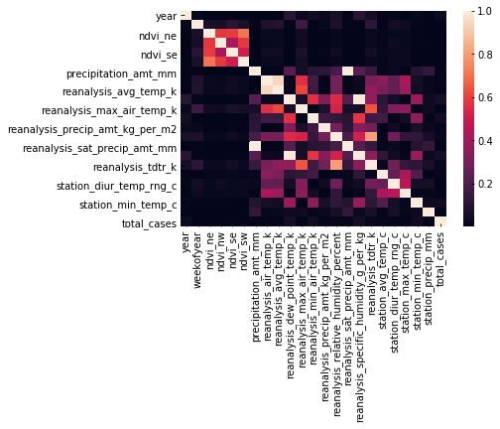
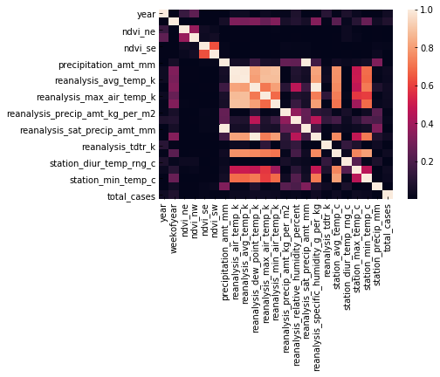
Results & Analysis ctd
Figure 1
Figure 2

Slide 13
Results & Analysis ctd
For XGBoost prediction, average NDVI score was used since they tend to correlate each other.
The prediction was not improved as expected.
Mean absolute error for XGBoost approach was 27.37
Finally a residual between the actual target and the predicted monthly trend was calculated.
The residual was predicted with weather features and added to the predicted trend.
It resulted in a mean absolute error of 20.77

Slide 14
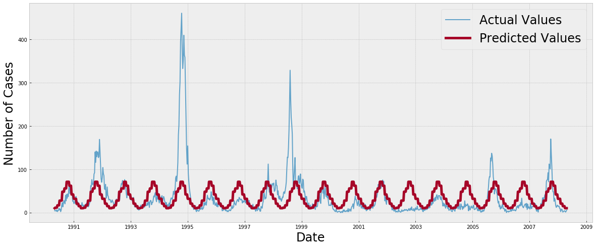
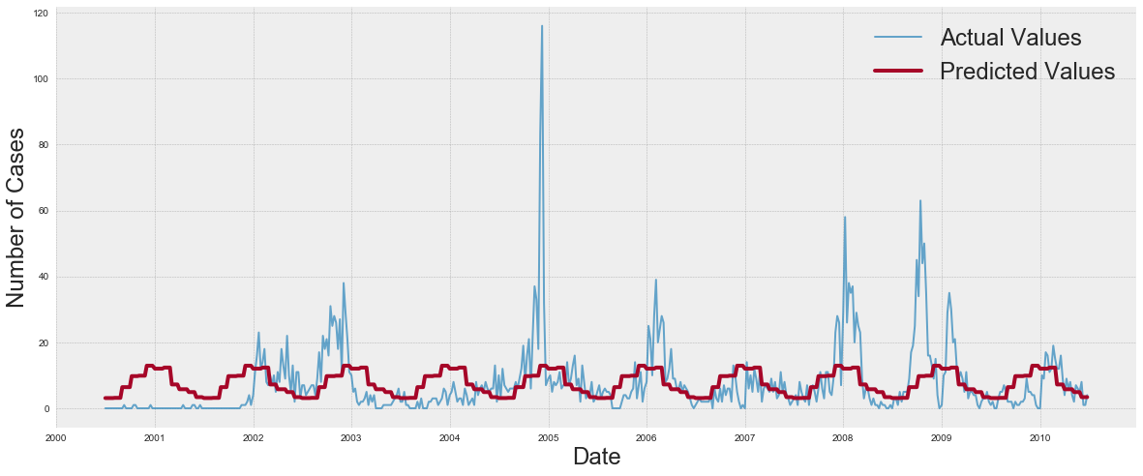
Results & Analysis ctd
Actual and Predicted Value - Iquitos
Actual and Predicted Value - San Juan

Slide 15
Conclusion
Front fill method of substitution for missing values did a fairly good job.
Averaging NDVI and temperature scores is better than using component features alone since they show a degree of correlation.
This leads to dimensionality reduction which may decrease the possibility of overfitting.
A prediction model alone could not achieve the desired accuracy, some feature selection and methodology is required to hit a lower error.
The residual between the predicted monthly trend and the actual target has been fairly modeled by weather data.
Thus weather features have captured slight variances in the predicting model.

Slide 16
Thank You !

